Slide 1

Be A Digital Ally:
Your Website’s Toolbox - Content Management systems and what you need to know
September 15, 2022
https://bit.ly/BADASEPT
Notes:
Speaker Notes
(next slide – SLIDE)

Slide 2
Welcome
Thank you for letting us be a part of your journey. We always strive to
Create inclusive and accessible spaces
Be kind, polite and respectful
Ensure Accessibility

Slide 3
Agenda
BADA Overview
Content Management Systems
Welcome
Introductions
What is Accessibility
Vocabulary Review
Things to Consider
Accessibility Features to look For
How to Fix or Improve your CMS
Notes:
Speaker Notes
(next slide – SLIDE)

Slide 4
We invite you to Be a Digital Ally
Monthly series
Goal: Cover the basic skills and principles behind accessible digital design
  Make digital content accessible to people with disabilities
Audience: Content creators of any skill level, but is new to accessibility

Slide 5
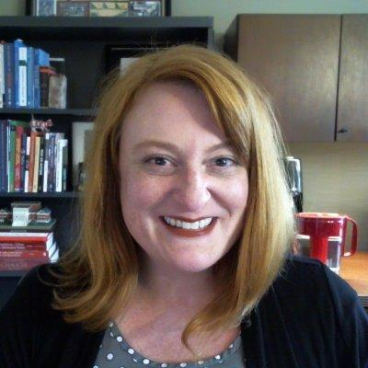
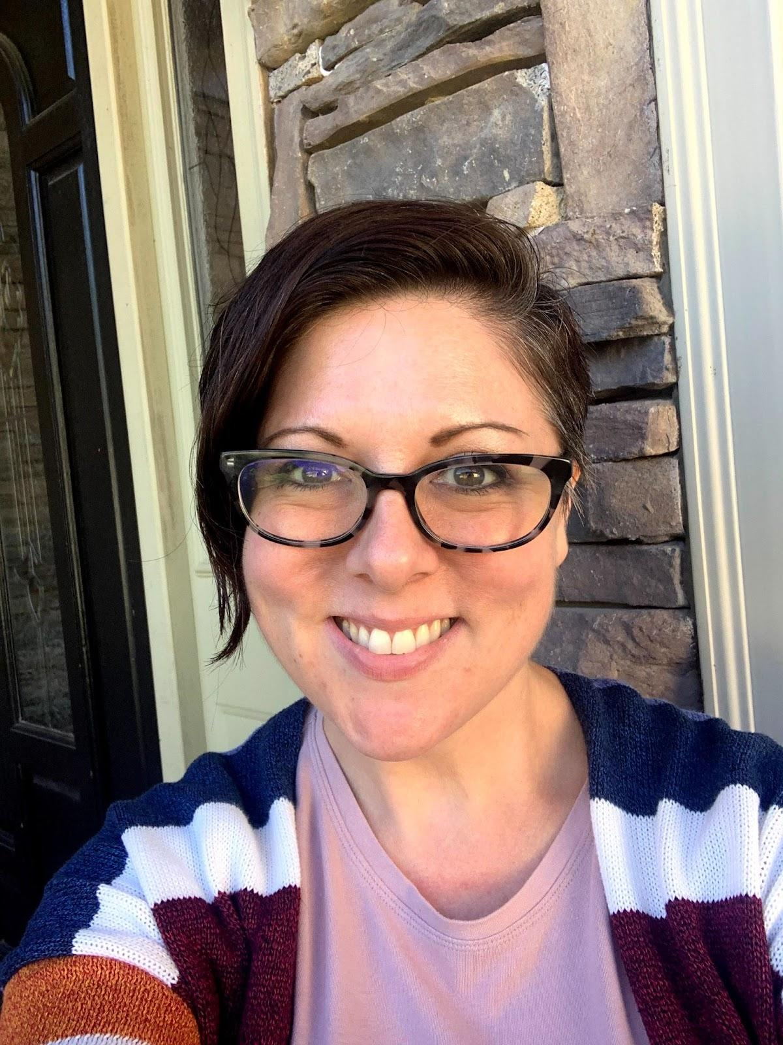

Introductions
Melissa Green
Digital Accessibility Specialist
“Jay” McKay, MT-BC, ATP
Director of Community Programs
Erica Braverman
Community Engagement Specialist

Slide 6
Knowbility
Founded in 1999
Knowbility is a 501 (c) (3) nonprofit that is based locally in Austin, TX but operates globally
Our mission is to create an inclusive digital world for people with disabilities

Slide 7
knowbility.org/donate
Community Programs
AIR
AccessU
AccessWorks
K12 Digital Accessibility
Be A Digital Ally

Slide 8
Definition of Accessibility
For something to be accessible, people can
Perceive
  Can they see & hear the content?
Understand
  Do they know where to go, what to do or what to expect?
Navigate
  Can they independently navigate using their preferred tools?
Interact
  Can they independently compete tasks and explore all areas?
Contribute
  Can they fully participate in an authentic manner?
w3.org - Accessibility Intro
AEM.cast.org - Designing for Accessibility with POUR

Slide 9
Why it’s Important to Design for It
15% of the world’s population lives with some form of disability
  Several people may not consider themselves disabled as defined by WHO
People without disability benefit from accessibility
WHO World Report on Disability 2011

Slide 10
What is Assistive Technology
“Assistive technology (AT) is any item, piece of equipment, software program, or product system that is used to increase, maintain, or improve the functional capabilities of persons with disabilities.” - ATIA
“Assistive technology enables and promotes inclusion and participation, especially of persons with disability, aging populations, and people with non-communicable diseases. The primary purpose of assistive products is to maintain or improve an individual’s functioning and independence, thereby promoting their well-being.“ - WHO
World Health Organization AT Fact Sheet
ATIA.org - What is AT?

Slide 11
Examples of Assistive Technology
Screen Reader
Refreshable Braille Display
Alternative Navigation Methods
  Keyboard Only
  Switch Use
Closed Captions
Transcripts
Magnification
Dark Mode/High Contrast
WebAIM examples

Slide 12
Accessibility is a Journey
“Do the best you can until you know better. Then when you know better, do better.” - Maya Angelou

Slide 13
Bonus Resources
The WebAIM Million - the 2022 report on the accessibility of the internet’s top million homepages
Ten Things to Consider when Choosing the Perfect CMS - 2009 article from Smashing Magazine

Slide 14
Vocabulary Review
The following are terms you may or may not be familiar with.
We are providing a very simplified definition or description of each to show the relationship to each other and their role in web design.
Notes:
Speaker Notes
(next slide – Accessible Document Overview)

Slide 15
URL
Uniform Resource Locator
The address people type in to get to your website
Also known as the Domain name

Slide 16
HTML
Hypertext Markup Language
Markup language
  What’s on your webpage
Used with other language systems to create your website

Slide 17
CSS
Cascading Style Sheets
Style Language
  How content is presented, how does it look?

Slide 18
JS
JavaScript
Programming language
  Rules for what happens on your webpage

Slide 19
ARIA
Accessible Rich Internet Application
Markup Language
  Provides additional information to those utilizing assistive technology to access your website
  used if you can’t do something in HTML

Slide 20
CMS
Content Management System
Software to edit and manage your website
Typically no coding required, but some have code editing options

Slide 21
CMS vs Hand Coding
Does not require coding
Requires very little technical knowledge
Multiple templates to choose from
  limited customization
Easy editing and management of your website
Can inhibit accessible design
Requires coding skills
Requires technical knowledge
Fully customize the site to your specific needs
Limited ease of editing
Ability to make site as accessible as possible

Slide 22
WYSIWYG
What You See Is What You Get
  typically refers to block editors (templates on a CMS, Mailchimp)
  also known as “Drag and Drop”

Slide 23
Things to Consider
Accessibility of CMS
Support for accessible content creation

Slide 24
Accessibility of CMS
Authoring tool interfaces follow applicable accessibility guidelines
Editing-views are perceivable
Editing-views are operable
Editing-views are understandable
Authoring Tool Accessibility Guielines (ATAG) 2.0, https://www.w3.org/TR/ATAG20/

Slide 25
Support for accessible content creation
Fully automatic processes produce accessible content
Authors are supported in producing accessible content
Authors are supported in improving the accessibility of existing content
Authoring tools promote and integrate their accessibility features
Authoring Tool Accessibility Guielines (ATAG) 2.0, https://www.w3.org/TR/ATAG20/

Slide 26
Also Look For
Ability to add fixes yourself
Ability to disable unnecessary features
User communities
CMS-specific considerations

Slide 27
How to Fix / Improve Your CMS
Key considerations
Keep It Short and Sweet
Think of alternate methods and workarounds
  Content
  Development
Other considerations
Where you can go for help
Notes:
Speaker Notes
(next slide – Accessible Document Overview)

Slide 28
Key Considerations
Accessibility is not an all or nothing outcome, so whatever improvements you can make will help!
If you must use a CMS that renders certain features in an inaccessible format, try to find alternatives
Good design across your site is key
Use your knowledge and resources to design for accessibility in the best way that you can!

Slide 29
Remember KISS
Keep it Short and Sweet
The simpler your content, the easier it is to keep your site accessible. Think about:
  Interactive elements
  How people find information
  Anything that requires specialized instructions
Example: static images on a webpage with the relevant information in a caption, instead of a carousel gallery with pop-out images

Slide 30
Alternate Methods and Workarounds: Content (1 of 2)
Does your CMS have a default login/password protected page that is not accessible?
  Consider a shared drive or email the private resources to your group
Is your site’s built in media player inaccessible?
  Keep your multimedia content on YouTube or Vimeo and embed the video or share a link on your site.

Slide 31
Alternate Methods and Workarounds: Content (2 of 2)
If you have forms on your site, can visitors save their work and finish later?
  Consider replacing long or complex forms with editable digital worksheets or templates if users cannot save their work in progress.
    Make sure you give instructions for the user on how to complete and submit the form
    Provide a phone number that users can call if they want to share their information verbally
Does your template leave out skip to main content links?
  Add your own link to the menu or the top of the page

Slide 32
Alternate Methods and Workarounds: Development
If your CMS is not accessible to contributors with disabilities, consider some of the following solutions:
  An accessible social media tool instead of a website to share photos and text posts
  If you are working on a newsletter, consider creating your newsletter content in a digital document and sharing it as a .docx file.
  If you want to try a new CMS, WordPress has an accessible editing tool (WordPress Classic)

Slide 33
Other Considerations (1 of 2)
Do you like the headings in your template?
  Style your headings so you like how they look in the correct order
Are your menus and navigation intuitive to use?
  Are your links clear about where they take the user?
Do your images have alt text?
  If you have complex images like charts or graphs, do you have a no-sight-required full written description?
Does your audio and video content have text alternatives?

Slide 34
Other Considerations (2 of 2)
Is your written content easy to read and broken into sections?
Have you checked your text for color contrast?
Are your form fields labeled correctly?
Do you have contact information listed on your site so visitors can get in touch with you if they find an accessibility issue or need help?
Is your mobile site just as easy and intuitive to use as your desktop site?

Slide 35
Finding Help and Guidance
If you get stuck with your CMS, there are many places you can look for help:
  Some CMS tools have online tutorials available
  Stack Overflow is a general purpose resource with lots of information on WordPress
  SquareSpace users can try the SquareSpace Forum
  Look for virtual or in person accessibility Meetups
    You might also try looking for meetups for developers who use the same CMS as you
    Reddit also has some communities for CMS users

Slide 36
Resources & Tools
WebAIM Contrast Checker
Guide to Heading Structure from the Big Hack
Authoring Tool Accessibility Guidelines
Deborah Edwards-Onoro/Lireo Designs
Be a Digital Ally
  Alternative Text
  Descriptive Links and Plain Language
  Captioning

Slide 37
Questions?

Slide 38
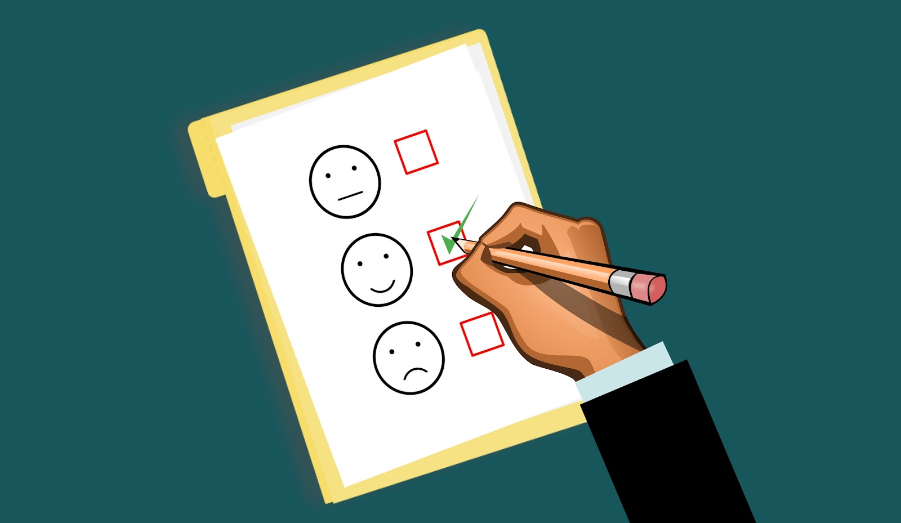
We love your feedback!
https://bit.ly/BADACMS

Slide 39
Next Session
Accessibility Checkers
October 20, 2022
5 pm - 6:30 pm CT
https://knowbility.org/DigitalAlly

Slide 40
Toolkit Tuesday!
Free Monthly Webinar focused on making K12 spaces accessible
September 27th 12-1 pm CT
Register through Humanitix

Slide 41
Thank You!
www.knowbility.org/donate

